Slide 1
Evaluating Trigonometric Functions of Any Angle

Slide 2
Reference Triangles & Angles Recap
Given the angle measure of $135°$, sketch the angle and the reference triangle and then find the reference angle.
How about $−60°$?
How about $\frac{2π}{3}$?

Slide 3
Finding all six trig functions recap
sin $θ$=
cos $θ$=
tan $θ$=
csc $θ$=
sec $θ$=
cot $θ$=
Let’s say that (-6, 8) is a point on the terminal side. How can we find the 6 trig. functions?

Slide 4
Ready for your worksheet?? ☺

Slide 5
$$\frac{15}{17}$$
$$\frac{17}{15}$$
$$\frac{4}{5}$$
$$\frac{5}{4}$$
$$\frac{8}{17}$$
$$\frac{17}{8}$$
$$−\frac{3}{5}$$
$$−\frac{5}{3}$$
$$\frac{15}{8}$$
$$\frac{8}{15}$$
$$−\frac{4}{3}$$
$$−\frac{3}{4}$$
$$−\frac{24}{25}$$
$$−\frac{25}{24}$$
$$−\frac{12}{13}$$
$$−\frac{13}{12}$$
$$−\frac{7}{25}$$
$$−\frac{25}{7}$$
$$\frac{5}{13}$$
$$\frac{13}{5}$$
$$\frac{24}{7}$$
$$\frac{7}{24}$$
$$−\frac{12}{5}$$
$$−\frac{5}{12}$$

Slide 6
$$−\frac{\sqrt{11}}{6}$$
$$−\frac{6\sqrt{11}}{11}$$
$$\frac{3\sqrt{13}}{13}$$
$$\frac{\sqrt{13}}{3}$$
$$\frac{5}{6}$$
$$\frac{6}{5}$$
$$−\frac{2\sqrt{13}}{13}$$
$$−\frac{\sqrt{13}}{2}$$
$$−\frac{\sqrt{11}}{5}$$
$$−\frac{5\sqrt{11}}{11}$$
$$−\frac{3}{2}$$
$$−\frac{2}{3}$$

Slide 7
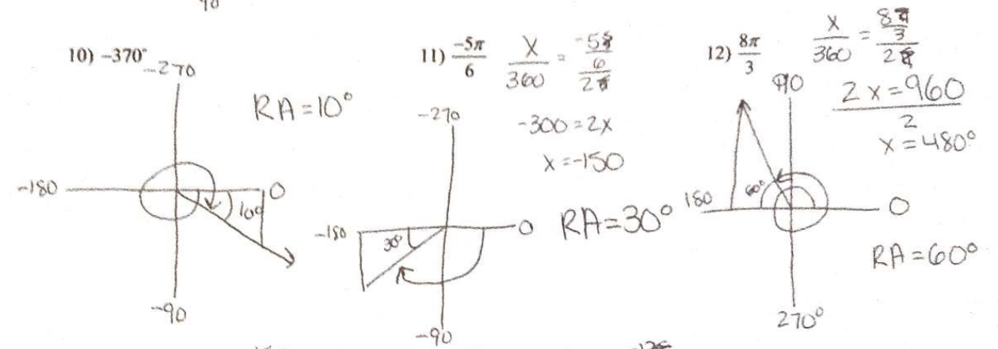

Slide 8
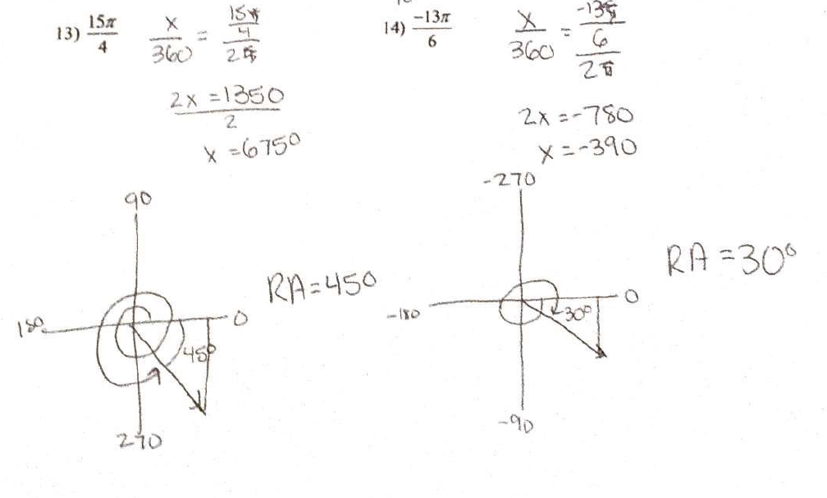

Slide 9
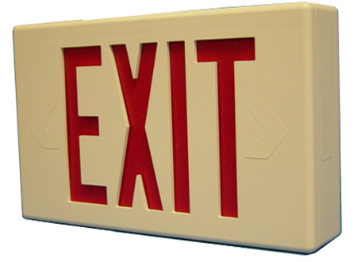
Evaluating Trigonometric Functions of Any Angle
Use the given point on the terminal side of an angle $θ$ in standard position to evaluate the six trigonometric functions of $θ$.
$$(\sqrt{5}, −2)$$

